Slide 1
IBM University Engagement Project Submission
“Exploring the Power of Agentic AI with IBM Granite and LangFlow”

Slide 2

Project Tile – AI-Powered Recipe Preparation Agent
Domain of Project – Healthcare / Food Technology / Artificial Intelligence
Student Name | Recent Passport Photo | Email ID | Mobile number [WhatsApp]
Gokulakrishnan.S |  | gokulmaha2206@gmail.com | 8825409970

Slide 3
Problem Statement -
Problem Statement : Recipe Preparation Agent
The Challenge:
Efficient meal preparation is essential for healthy living, but individuals frequently struggle with pantry inventory management, ingredient wastage, and decision fatigue when cooking at home. Information regarding recipe adaptations, cooking techniques, and ingredient substitutions is scattered across static culinary platforms. Without personalized, real-time guidance, many fail to utilize available household ingredients effectively or adapt recipes to their dietary needs.
The Objective:
Build an AI-powered Recipe Preparation Agent that delivers personalized culinary guidance and pantry-focused meal solutions for home cooks and busy individuals. The solution should:
Zero-Waste Pantry Cooking – Recommend tailored recipes based strictly on user-provided ingredients on hand.
Recipe RAG Retrieval – Fetch and summarize structured preparation steps, cooking times, and ingredient proportions from reliable knowledge bases.
Dynamic Ingredient Substitutions – Suggest suitable alternative ingredients when essential items are missing.
Step-by-Step Culinary Guidance – Provide actionable, easy-to-follow cooking instructions tailored to the user's skill level.
Multi-Agent System –
Pantry Inventory Agent (parses and matches available ingredient inputs)
Recipe Recommendation Agent (generates context-aware meal options)
Substitution & Culinary Advisory Agent (provides smart dietary swaps and chef tips)
Meal Planning & Feedback Agent (tracks saved recipes and user preferences)
Interactive UI Dashboard – Display structured recipe cards, step-by-step guidance, substitution matrices, and cooking tips in real time

Slide 4
Proposed Solution -
The proposed solution is a multi-agent AI-powered Recipe Preparation Agent built using LangFlow, IBM watsonx.ai, and Granite Models to provide personalized, real-time culinary guidance. The system addresses challenges in pantry management, ingredient waste, and meal decision fatigue through an intelligent, modular architecture.
At its core, the solution uses a Retrieval-Augmented Generation (RAG) pipeline to fetch accurate culinary data from trusted JSON knowledge bases and recipe datasets. This data is indexed and retrieved to enable the system to parse available ingredients and summarize step-by-step cooking procedures, ingredient swaps, and preparation tips using Granite models.
The system consists of four key agents:
Pantry Inventory Agent retrieves and matches available ingredient inputs using RAG.
Recipe Recommendation Agent generates personalized cooking options based on available pantry items, dietary preferences, and cooking time.
Substitution & Culinary Advisory Agent provides smart ingredient swaps (e.g., alternative sauces or spices) and expert cooking tips.
Meal Planning & Feedback Agent tracks saved user preferences, ingredient availability, and recipe history.
The solution includes a user-friendly dashboard (built with Streamlit) that visualizes step-by-step instructions, ingredient checklists, dynamic substitutions, and chef guidance in real time.
LangFlow is used to orchestrate agent workflows, while watsonx.ai ensures scalable model deployment, embeddings, and AI governance. Granite models power reasoning, summarization, and step-by-step personalization.
Overall, this solution delivers an end-to-end intelligent recipe assistant that eliminates food waste and simplifies home cooking through personalized pantry insights, dynamic substitutions, and real-time culinary recommendations.

Slide 5
Technology Used
Langflow platform – For designing and orchestrating multi-agent workflows visually.
IBM Granite model – (e.g., ibm-granite-3-2-8b) – For natural language understanding, reasoning, step-by-step cooking logic, and personalization.
IBM Cloud – Provides the infrastructure to build, deploy, and scale the Recipe Preparation Agent efficiently. IBM Cloud enables a reliable, secure, and scalable environment for deploying the Recipe Preparation Agent.
RAG – RAG to fetch real data first, then generate intelligent answers, making the Recipe Preparation Agent more trustworthy, accurate, and effective.
IBM Watsonx.ai – For model deployment, embeddings, and AI governance.
Vector Database / JSON Base – For RAG-based recipe, ingredient, substitution, and cooking tip data retrieval.

Slide 6
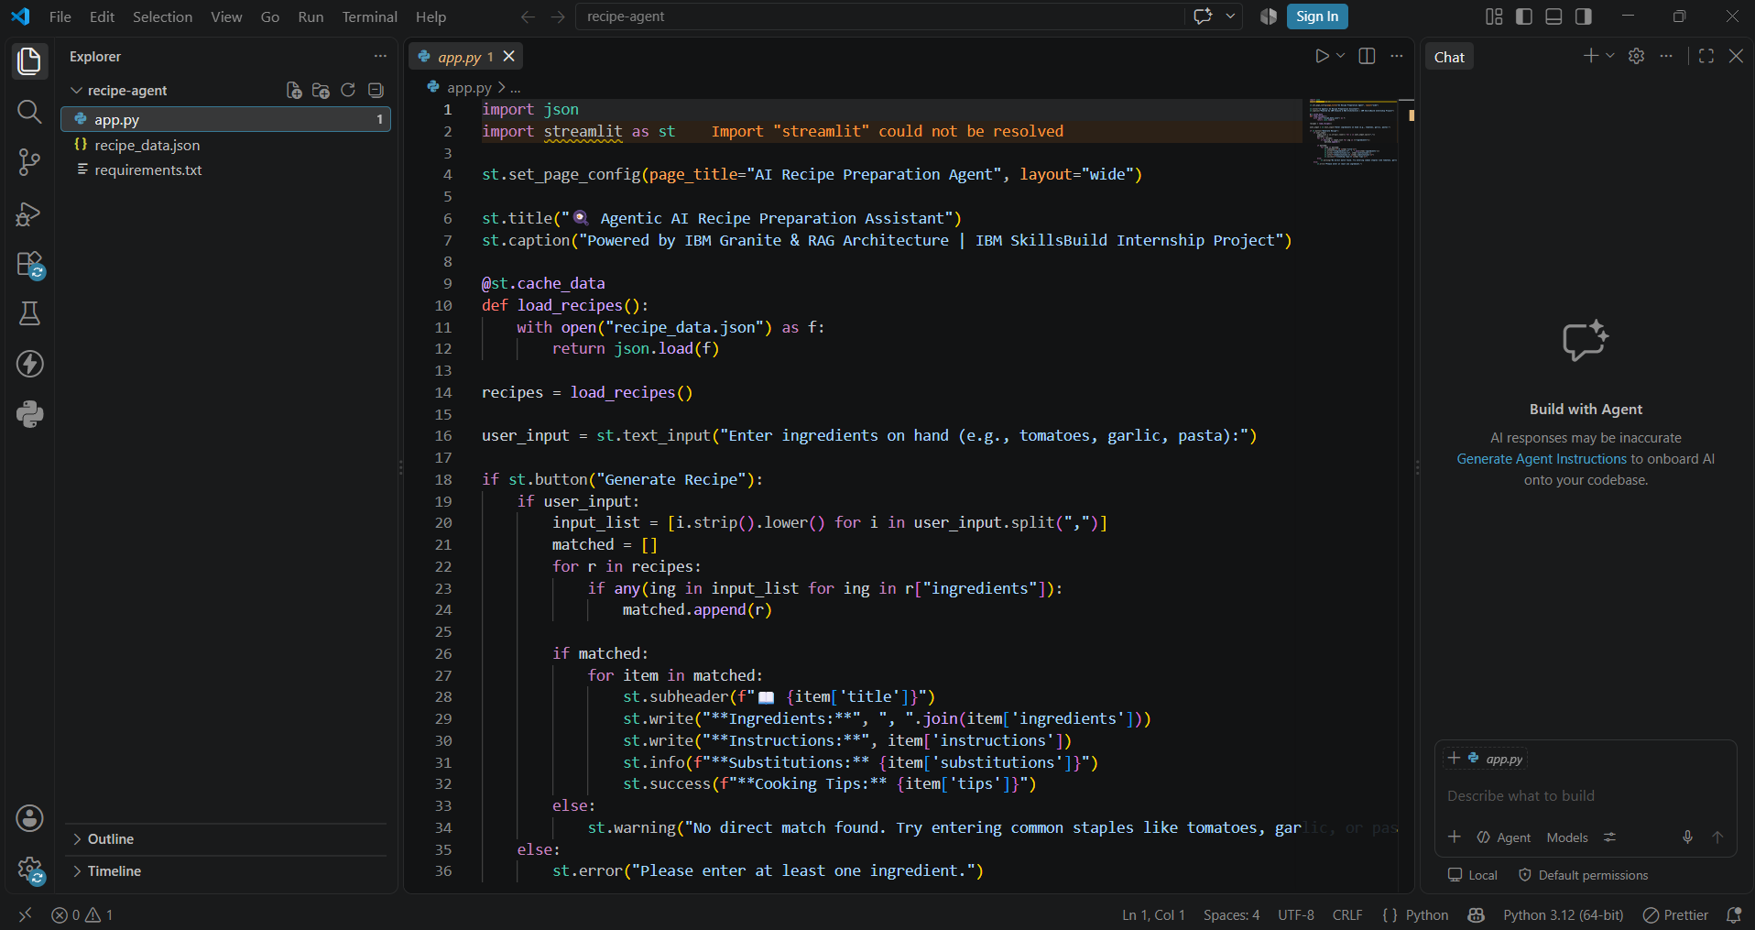
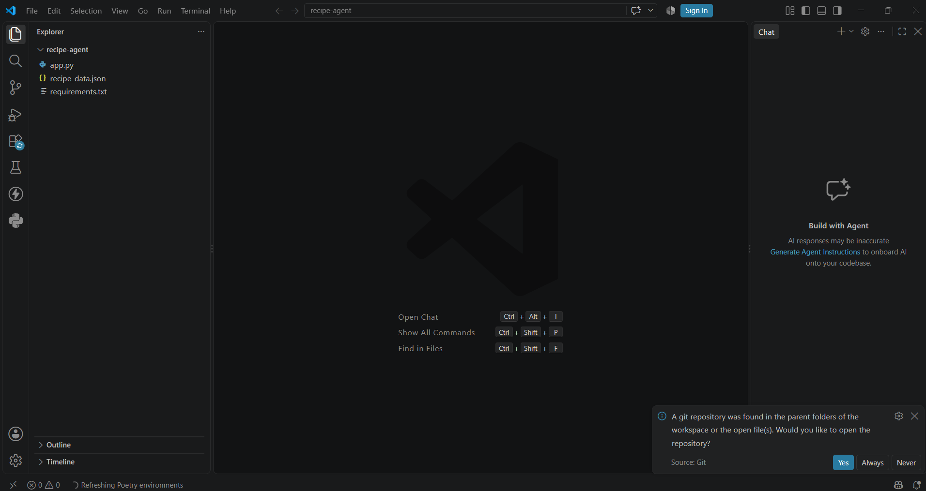
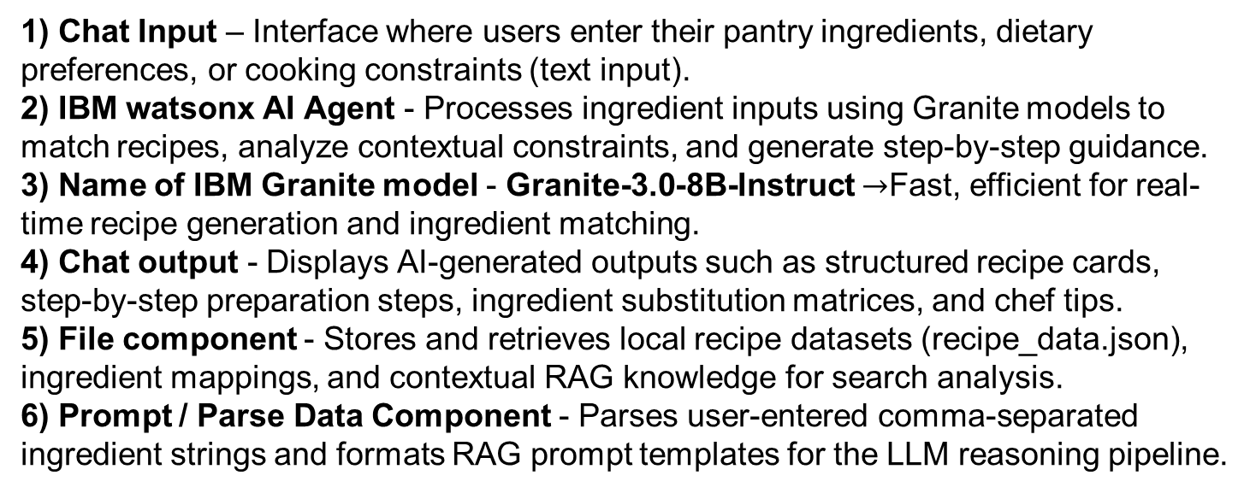
Langflow component Used -
1) Chat Input – Interface where users enter their pantry ingredients, dietary preferences, or cooking constraints (text input).
2) IBM watsonx AI Agent - Processes ingredient inputs using Granite models to match recipes, analyze contextual constraints, and generate step-by-step guidance.
3) Name of IBM Granite model - Granite-3.0-8B-Instruct $→$Fast, efficient for real-time recipe generation and ingredient matching.
4) Chat output - Displays AI-generated outputs such as structured recipe cards, step-by-step preparation steps, ingredient substitution matrices, and chef tips.
5) File component - Stores and retrieves local recipe datasets (recipe_data.json), ingredient mappings, and contextual RAG knowledge for search analysis.
6) Prompt / Parse Data Component - Parses user-entered comma-separated ingredient strings and formats RAG prompt templates for the LLM reasoning pipeline.

Slide 7

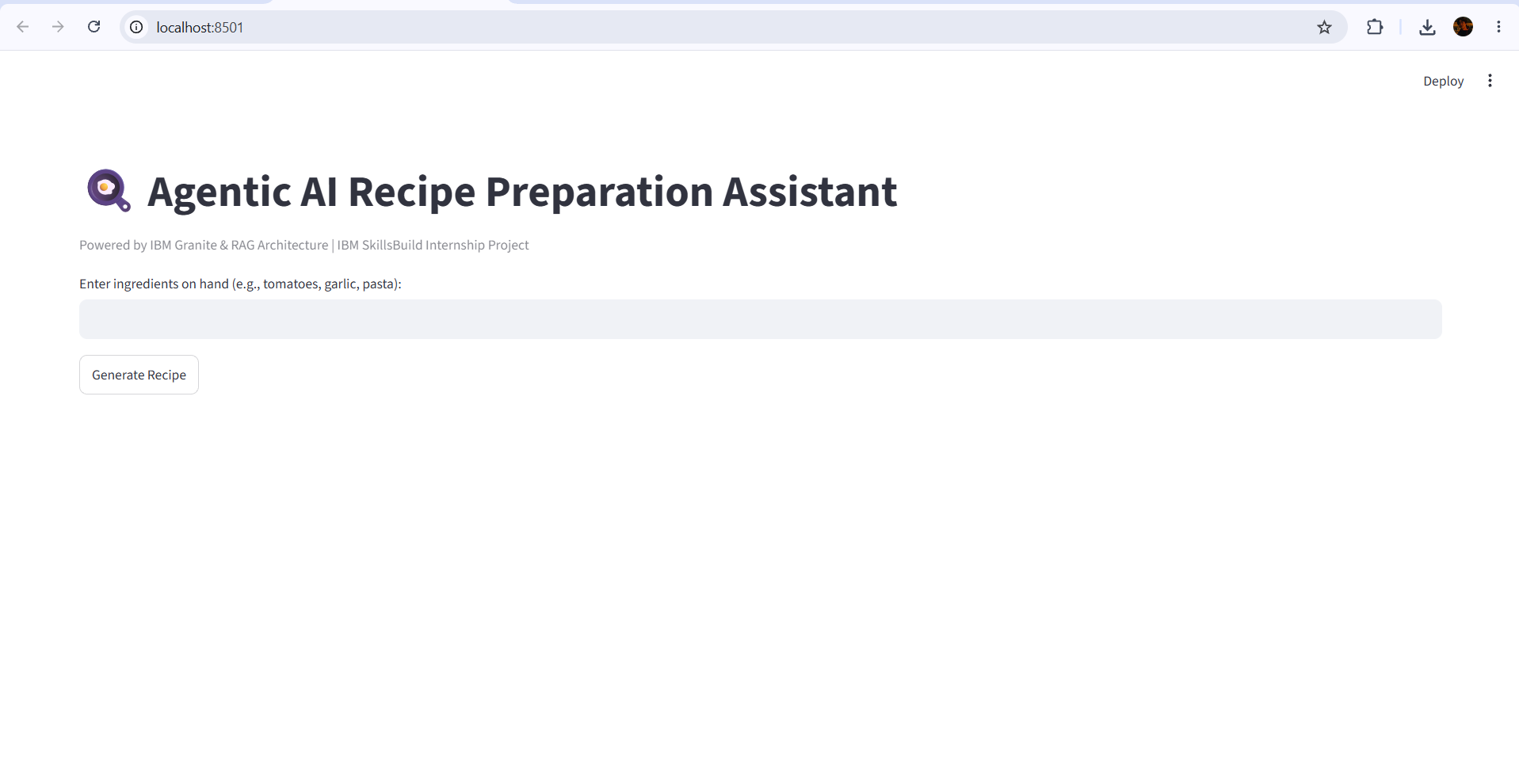
Role of Agentic AI in the solution
Agentic AI enables the Recipe Preparation Agent to function as an intelligent, autonomous system rather than a simple chatbot. Using IBM watsonx.ai and IBM Granite models, it coordinates multiple specialized agents to deliver personalized culinary guidance.
Each agent performs a specific role—such as retrieving recipe data, generating step-by-step instructions, providing dynamic ingredient substitutions, and offering culinary tips—while working collaboratively. This multi-agent approach ensures efficient task execution and accurate results.
Agentic AI also brings context awareness, understanding user details like available pantry items, dietary preferences, and skill levels to generate tailored recommendations. It supports real-time adaptation, continuously updating suggestions based on user inputs like available groceries.
Additionally, agents communicate with each other, enabling better decision-making and improved outcomes.
Overall, Agentic AI makes the system proactive, personalized, and goal-driven, acting like a smart digital chef that helps users minimize food waste and simplify home cooking.

Slide 8
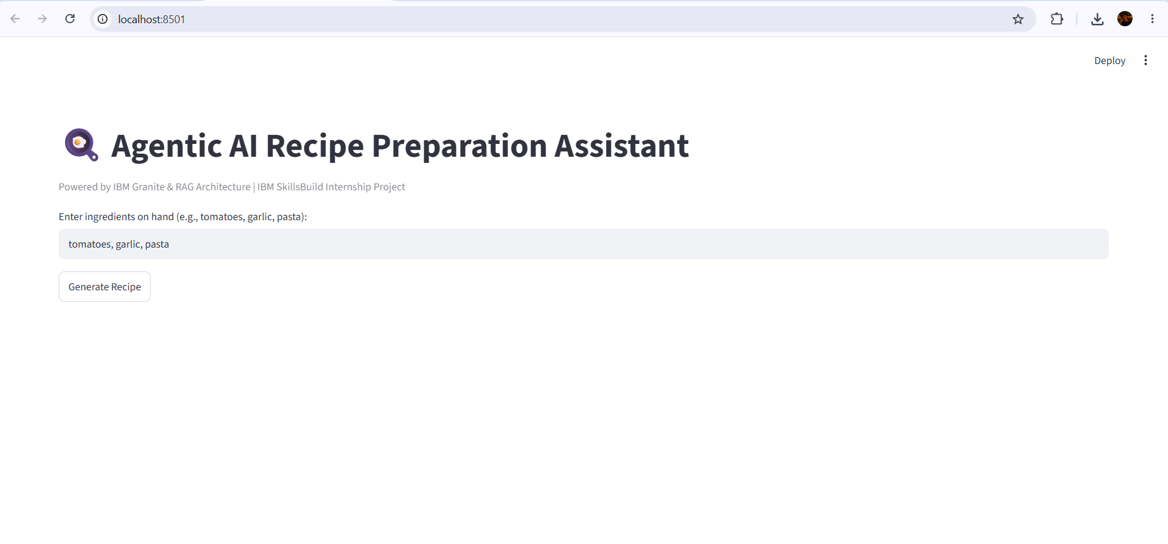
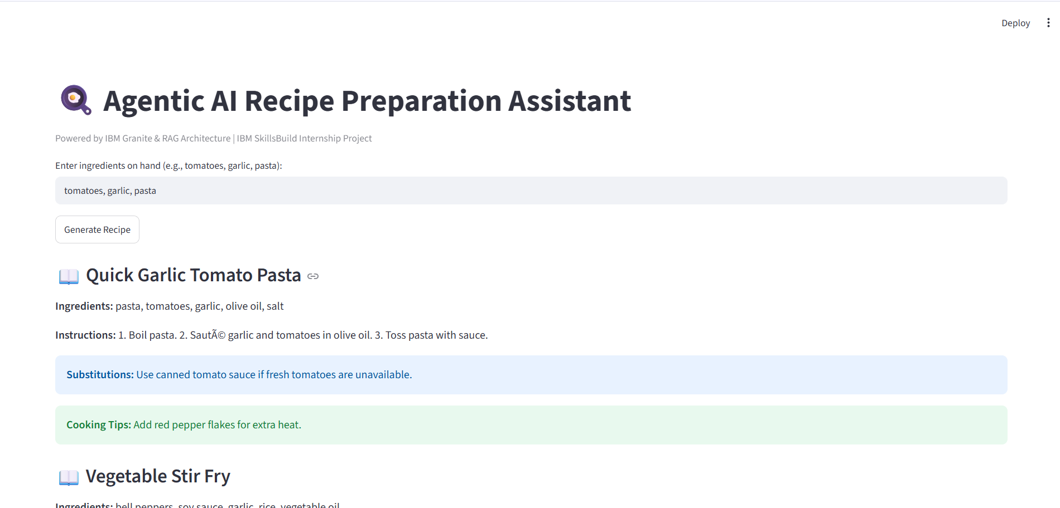
Token Usage

Slide 9
Novelty and Uniqueness
The proposed Recipe Preparation Agent stands out by combining Agentic AI, RAG, and personalization into a single intelligent system.
Multi-Agent Intelligence – Instead of a single chatbot, multiple specialized agents collaborate to deliver accurate and context-aware culinary guidance.
RAG-Based Accuracy – Integrates real-time data retrieval with AI generation, reducing hallucinations and ensuring accurate recipe steps and measurements.
Hyper-Personalization – Tailors meal recipes based on available pantry items, dietary restrictions, and cooking preferences.
Real-Time Feedback Loop – Continuously adapts recommendations based on user feedback and available grocery stock.
Multi-Modal Input – Supports text, voice, and image-based ingredient tracking for better usability.
Zero-Waste Focus – Goes beyond standard cooking apps by prioritizing pantry inventory to eliminate household food waste.
Scalable & Enterprise-Ready – Built on IBM watsonx.ai with IBM Granite models, ensuring reliability and governance.
This makes the solution a smart, adaptive, and proactive digital chef, not just a static recipe search engine

Slide 10
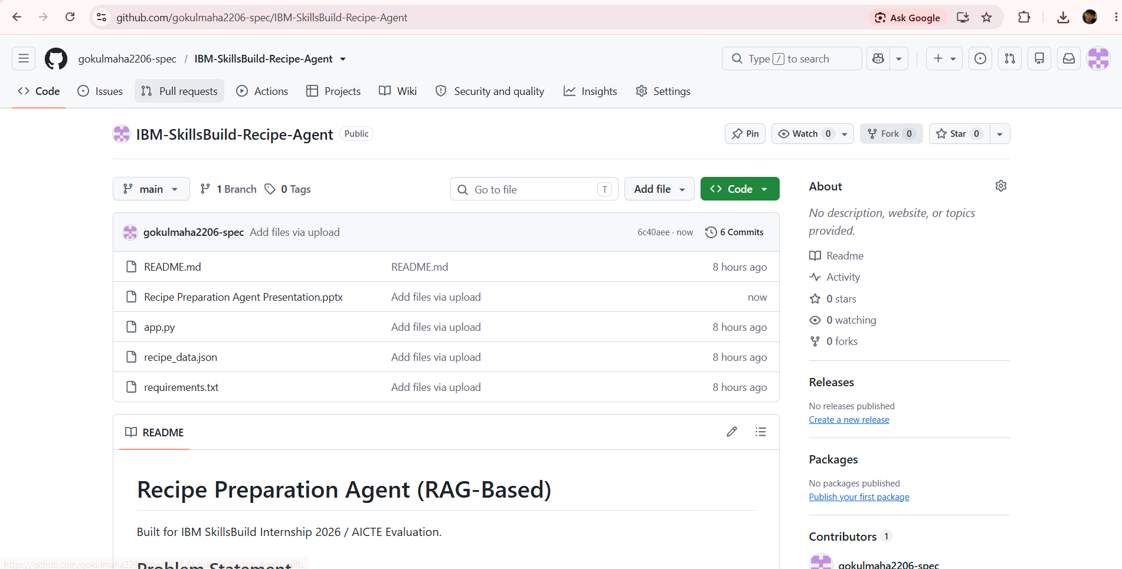
Git Hub Link
Paste the working Github URL – https://github.com/gokulmaha2206-spec/IBM-SkillsBuild-Recipe-Agent.git 1) app.py , 2) Problem Statement-16: Recipe_Agent .pdf 3) Recipe Preparation Agent Presentation.pptx 4) recipe_data.json 5) requirements.txt
·
·
·

Slide 11
Future Scope
1. Integration with Smart Kitchen Appliances & IoT Pantry Sensors – The system can be integrated with smart refrigerators, barcode scanners, and IoT pantry weight sensors to maintain real-time inventory tracking. This will enable the Recipe Preparation Agent to automatically detect available ingredients and suggest recipes without manual user input.
2. AI-Powered Voice Assistant & Multilingual Support – Enhancing the system with hands-free, voice-guided cooking instructions and support for multiple regional languages will improve accessibility during meal preparation. Users can interact naturally in their preferred language while cooking, making the solution more inclusive and suitable for diverse populations.
·
·
·

Slide 12
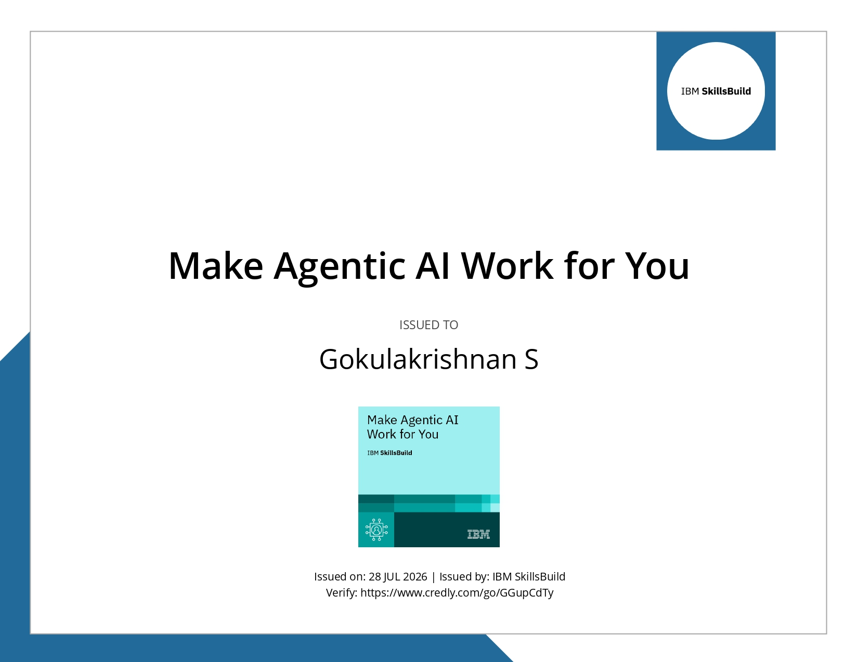
Certificates Earned:
Please add your credly certificate

Slide 13
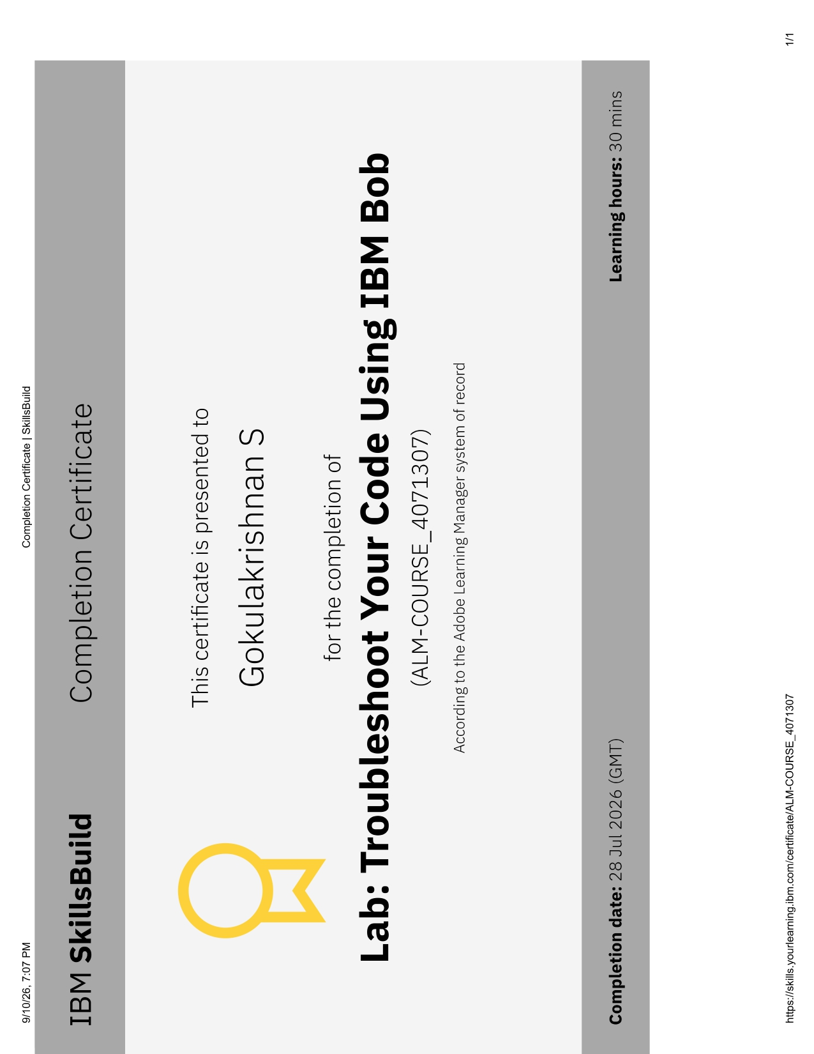
Certificates Earned:​
Add your IBM BOB Certificate

Slide 14


